Slide 1



SMOKE DETECTOR DEVICE
STAT 4650: ML Project
December 2022
Prepared by: Ritu Shrestha, Maryam Ahmadi , Bishal Thakur
Advisor: Professor Yue Gao

Slide 2
Contents
Background
Introduction
1
Motivation
Methods
3
2
Dataset main information
Descriptive Analysis
5
4
Results
Analysis
Predictive Analysis
6
Takeaways, Implications
Notes:
مدل ریاضیاتی
نتایج عددی به دست آمده
بررسی‌های ادبی و تحلیل حساسیت‌های مدل
جمع‌بندی-> نتایج به دست آمده

Slide 3
INTRODUCTION
Aimed at detecting the presence of fire.
Sensor uses different particles of the environment
  Air pressure
  Temperature
  Humidity
  Raw ethanol
  Raw molecular hydrogen
  Carbon dioxide concentration
False alarm
  No fire all the time
  Focuses on minimizing error rates.
3

Slide 4
BACKGROUND
Smoke alarms in conjunction with other fire safety regulation has helped drop the number of fire victims.
One home structure fire was reported every 93 seconds.
One home fire-related injury occurs every 47 minutes.
One home fire-related death occurs every 3 hours and 8 minutes.
In 2021, 1,353,500 fires resulted in 3800 civilian deaths and 14,700 injuries.
Out of 96% of the residential houses in US that have fire alarms installed, approximately 20% don’t operate.
If the house has a proper functioning smoke detector, risk of death in a house fire is decreased by 55%.
Approximately 57% of the fire death occurs in the properties without a smoke detector.
It is expected that residential fire deaths could be dropped by 36% per year if every home in US has working fire alarms.
4

Slide 5



BUSINESS PROBLEM
False Alarm
No True Fire Alert
Variable Closely Related to Fire
Distrustful
Increase in complaints
Decrease in sales
No Alert even when the presence of fire
Riskier and more dangerous
Useful for accurate prediction
Reduction in error rates
5

Slide 6
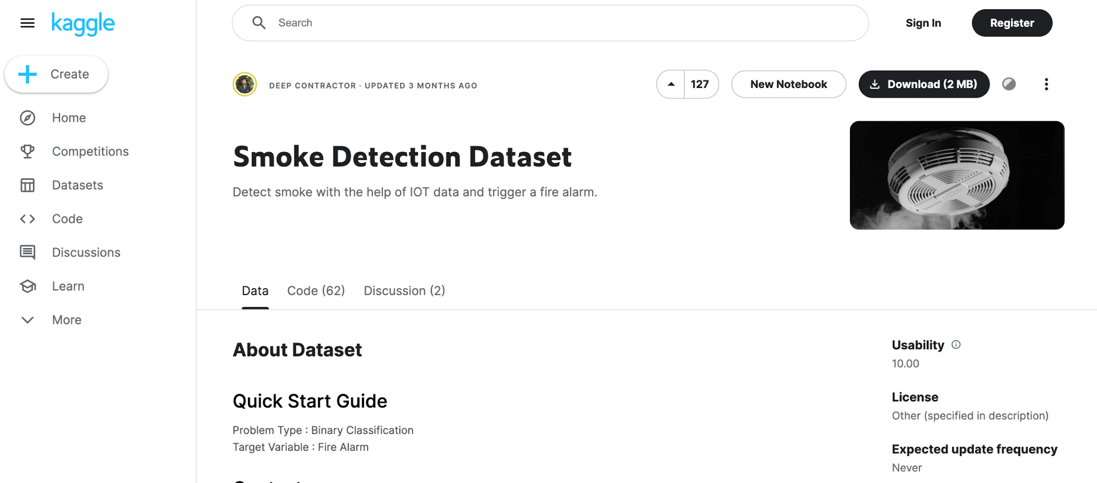
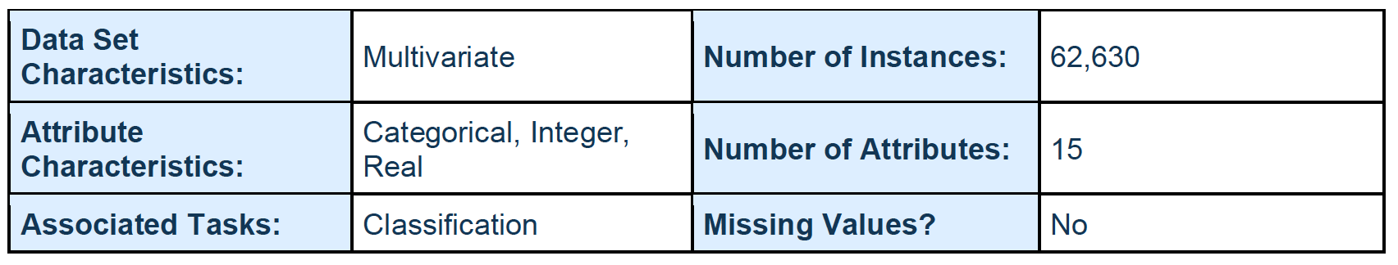
DATASET MAIN INFORMATION
6

Slide 7
DATASET FEATURES: DESCRIPTION
Air Temperature
Air Humidity
TVOC: Total Volatile Organic Compounds; measured in parts per billion. These are organic compounds that have a high vapor pressure at room temperature.
eCO2: co2 equivalent concentration; calculated from different values like TVCO.
Raw H2: raw molecular hydrogen; not compensated (Bias, temperature, etc.)
Raw Ethanol: raw ethanol gas.
Air Pressure
PM 1.0 and PM 2.5: particulate matter size < 1.0 μm (PM1.0). 1.0 μm < 2.5 μm (PM2.5)
7

Slide 8
DATASET FEATURES: DESCRIPTION
Fire Alarm: ground truth is "1" if a fire is there.
CNT: Sample counter.
UTC: Timestamp UTC seconds.
NC0.5/NC1.0 and NC2.5: Number concentration of particulate matter. This differs from PM because NC gives the actual number of particles in the air. The raw NC is also classified by the particle size: < 0.5 μm (NC0.5); 0.5 μm < 1.0 μm (NC1.0); 1.0 μm < 2.5 μm (NC2.5).
8

Slide 9
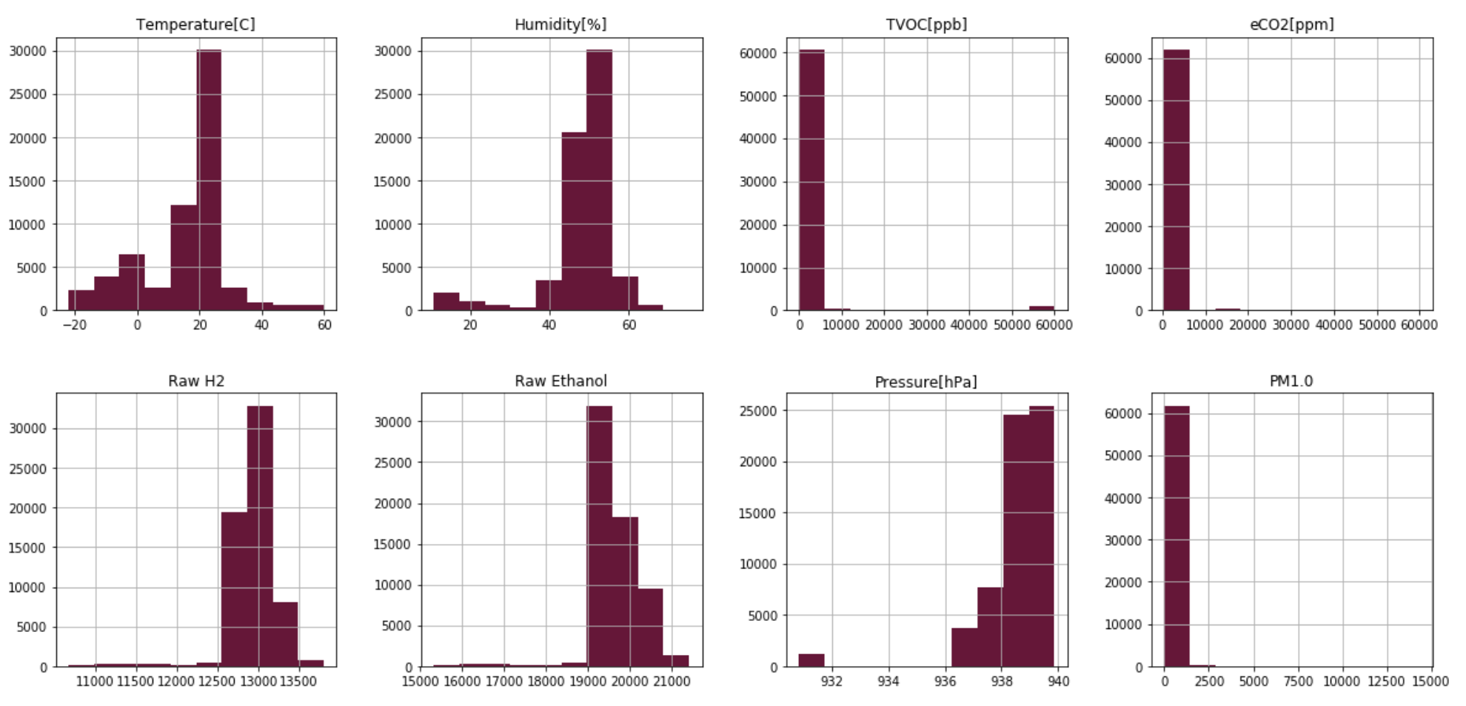
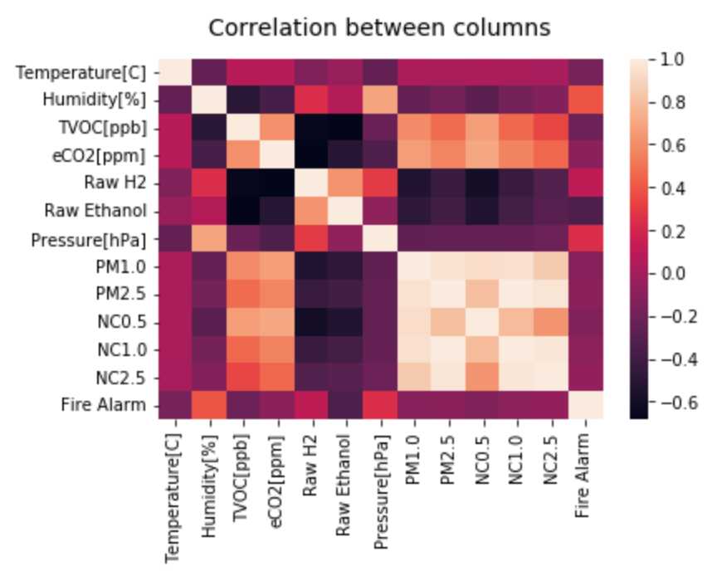
DESCRIPTIVE ANALYSIS
9
Notes:
Maybe Cutted

Slide 10


ANALYSIS METHODS
Dataset Features Description
Columns: 1- CNT, 2- UTC,
3-'Unnamed: 0'
Under-Sampling
Remove useless columns
Scale (Standardize)
Splitting Data 80:20 for training and testing
Supervised
Learning
Decision Tree
Random Forest
Logistic Regression
Gaussian Naive Bayes
K-Nearest Neighbors
Voting Classifier
10

Slide 11
PREDICTIVE ANALYSIS
Model | Accuracy | Precision | Recall | F1-score
Decision Tree | 0.99 | 1.00 | 1.00 | 1.00
Random Forest | 0.99 | 1.00 | 1.00 | 1.00
Logistic Regression | 0. 87 | 0.88 | 0.88 | 0.88
Gaussian Naive Bayes | 0.62 | 0.75 | 0.62 | 0.56
Voting Classifier | 1.00 | 1.00 | 1.00 | 1.00
KNN | 1.00 | 1.00 | 1.00 | 1.00
11
Notes:
Maybe Cutted

Slide 12
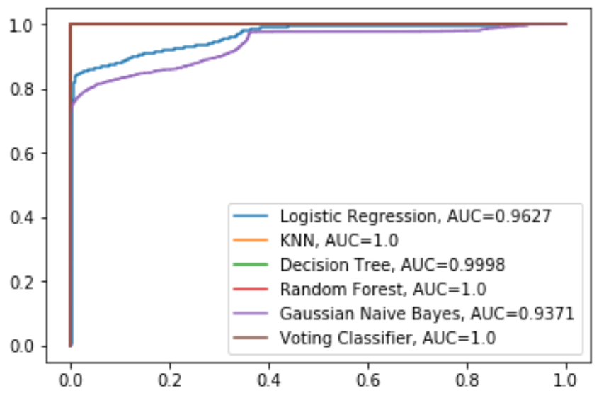
Compare Models Using the Area Under the ROC Curve
12

Slide 13

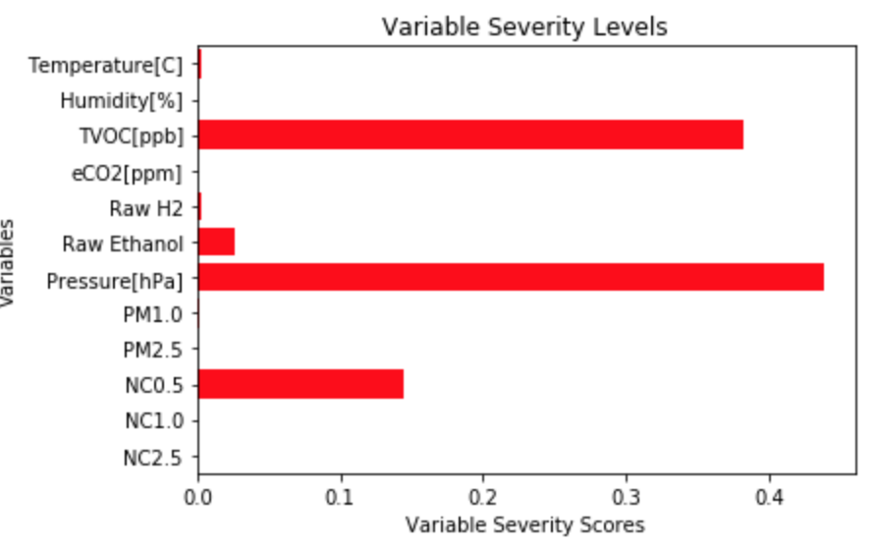
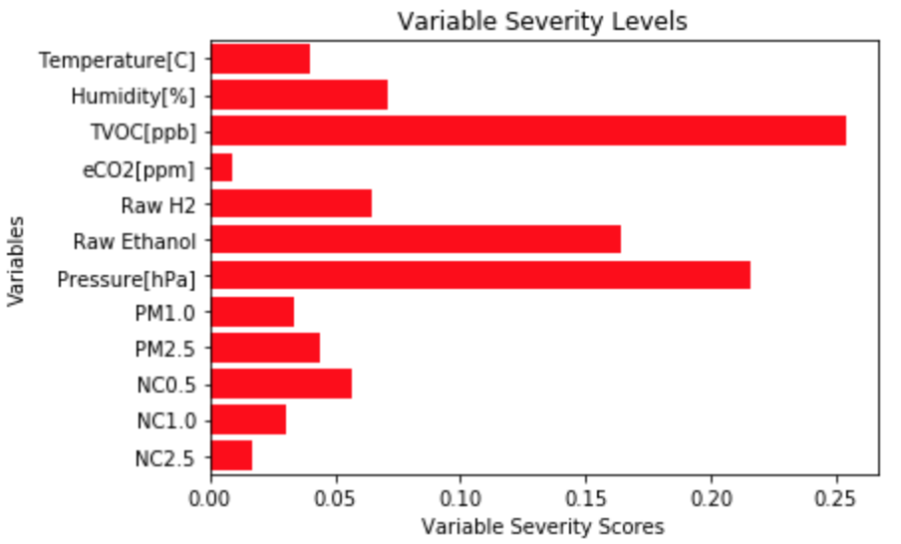
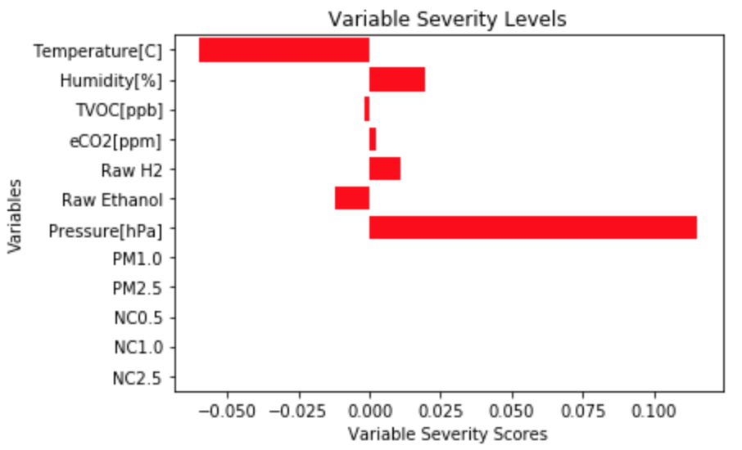
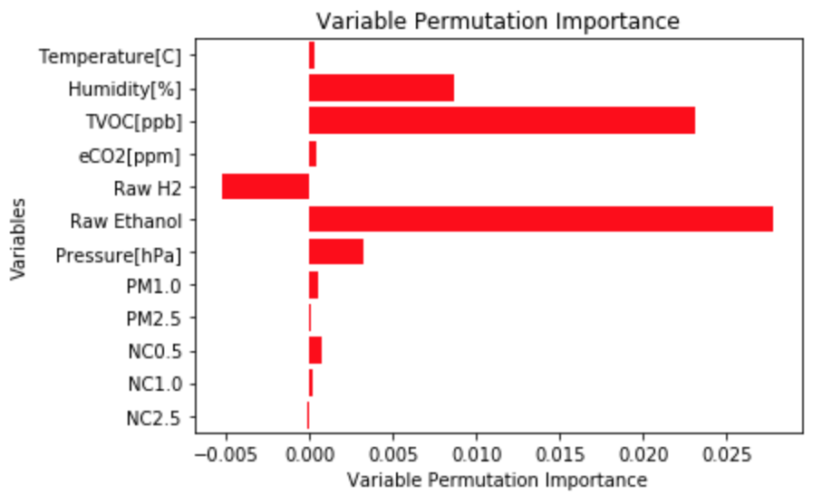
2
FEATURE IMPORTANCE
Decision Tree
G. Naïve Bayes
Logistic Regression
13

Slide 14





2
CONCLUSION
Our results indicate that the model that works best for our dataset is Random forest and Decision trees.
Decision Tree Accuracy – 99.98%
Random forest accuracy – 99.99%
The logistic regression was used to classify as 0 (no fire) or 1 (fire present) and it showed the results with an accuracy of 87.75 %
Our misclassification rate = 3/5726 = 0.005 % which is quite low.
Hence, our system is designed to be quite accurate.
14

Slide 15
2
RESULTS
Our models show a high degree of accuracy and a low prediction/misclassification rate.
In our case, it is imperative to have the fire alarm go off rather than not.
A Type-2 error, false negative, which implies the that fire bell does not go off even in case of fire.
This could be potentially life-threatening.
15

Slide 16
2
BUSINESS IMPLICATIONS
Fire alarms are produced by firms such as Bosch, Honeywell, United Tech Corp and Bay Alarm
For businesses, this means that the trade-off should be maintained between Specificity and Sensitivity.
Our AI-based fire alarm will only go off when there is an actual fire inside the house.
Businesses could market these new-age fire-alarms as more accurate and user-friendly.
16

Slide 17
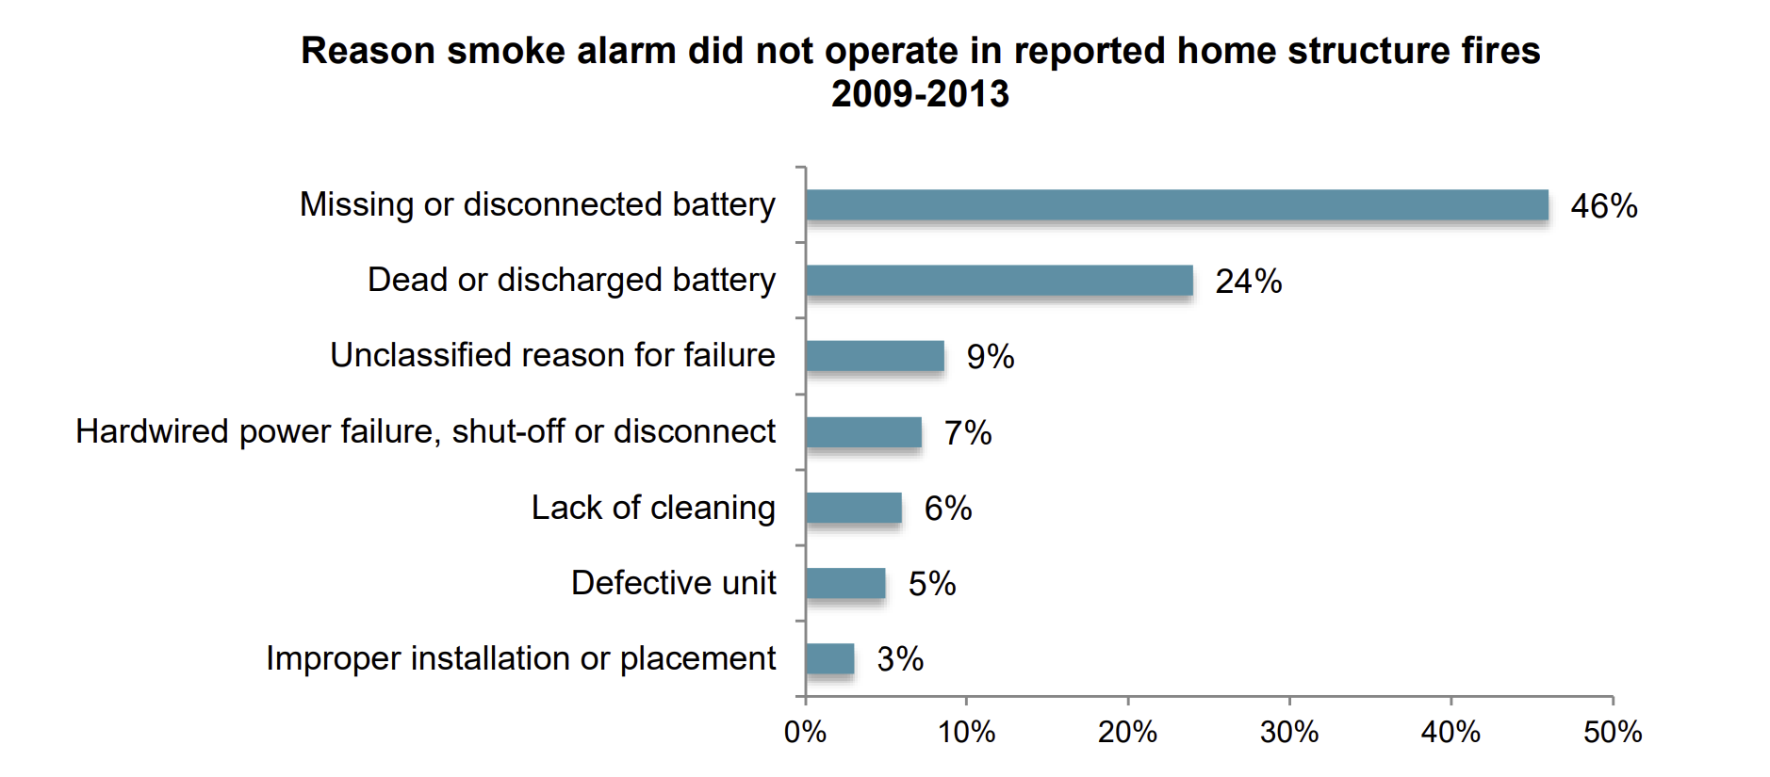
2
LIMITATIONS
17

Slide 18
2
THANK YOU!

